Slide 1
Product Training
Supplier Review
Where “Lean” principles are considered common sense and are implemented with a passion!

Slide 2
Supplier Review
Supplier Review is used to see an overview of a supplier account. AP transactions as well as purchase orders can be viewed from Supplier Review

Slide 3
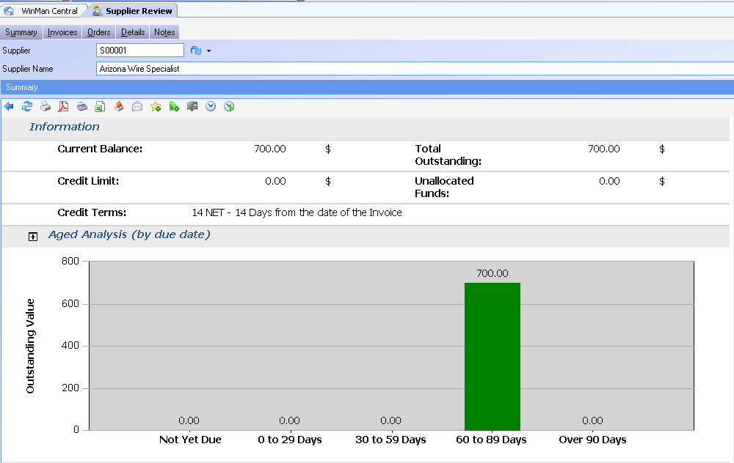
Supplier Review
Summary Tab
The Summary tab will display an overview of the account.
Current Balance – The outstanding balance on the supplier account minus any unallocated funds.
Total Outstanding – Total of all outstanding AP transactions
Credit Limit – The credit limit of the supplier as found in the supplier master
Unallocated Funds – Any unapplied cash transactions
Aged Analysis – A graph showing the outstanding invoice transactions and their aging buckets

Slide 4
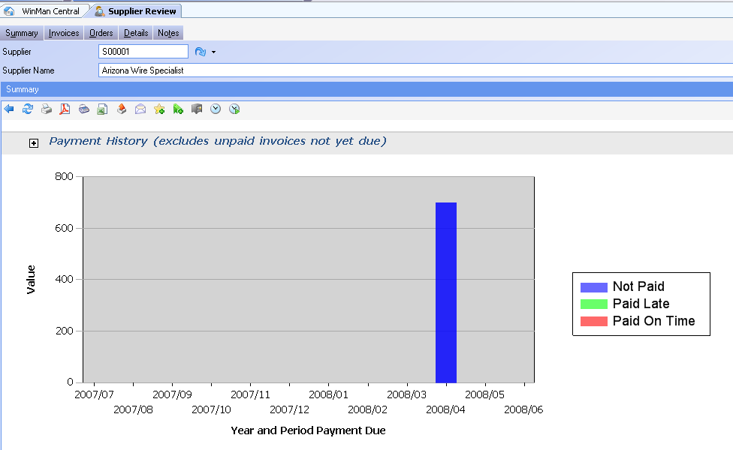
Supplier Review
Summary Tab
Payment History can be viewed below the Aged Analysis
Payment history shows payments for the last year

Slide 5
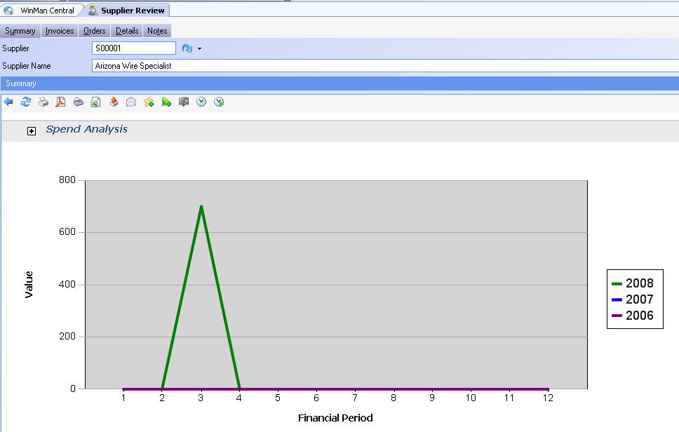
Supplier Review
Summary Tab
The Spend Analysis graph can be found below the payment history graph
Graph displays invoice values for the last 3 years by GL periods

Slide 6
Supplier Review
Summary Tab
Supplier transactions can be found below the Spend Analysis graph
Last Movements, Order history, Goods Receipts History, Invoice history and Payment history can all be viewed
Click on a transaction to drill down for more detail.

Slide 7
Supplier Review
Invoices Tab

Slide 8
Supplier Review
Invoices Tab
Supplier AP transactions including Purchase Invoices, Credits, Cash Payments, and Cash Receipts from Suppliers can be viewed.
All open AP transactions will be displayed as well as closed transactions that are less than 20 days old.
Right click on a transaction to move the transaction to another customer
SYSTEM SETTING: By default, closed transactions older than 20 days will not be displayed on the Invoices tab. To increase the number of days of closed transactions use the Supplier Review system option Days to look back for supplier review. Enable the option and set the value to the number of days to look back for closed transactions. The higher the number the longer it may take for the screen to retrieve data from the server.
SYSTEM SETTING: Invoices with a value outstanding can be written off by right clicking on the invoice and selecting the menu item Write this item off. A maximum write off value can be set so that transactions exceeding the value may not be written off. Use the Supplier Review system option Purchase invoice write off threshold. Enable the option and set the value to the maximum write off value.

Slide 9
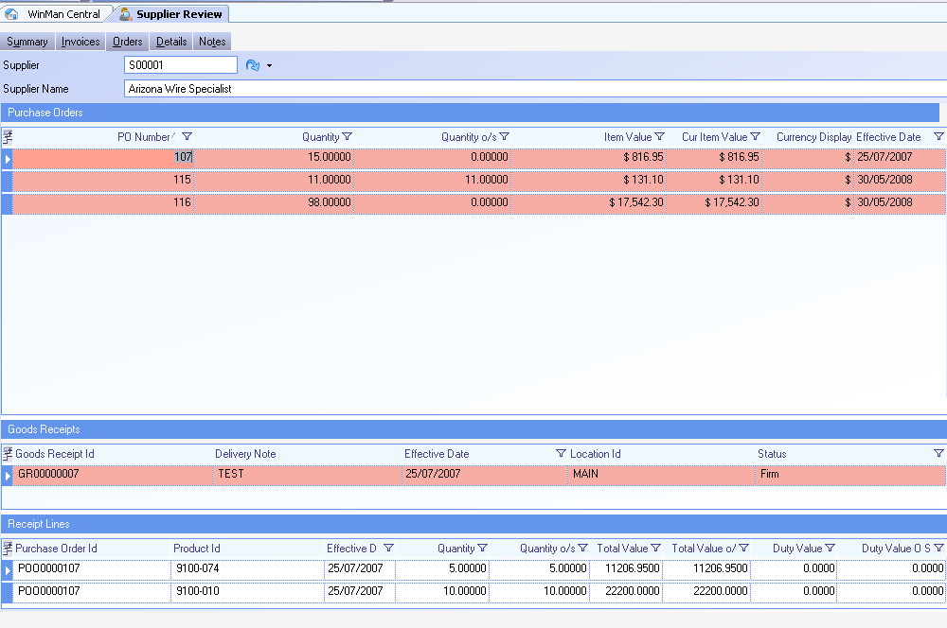
Supplier Review
Orders Tab
Orders for the supplier can be viewed.
Select or click on an order to view goods receipts and goods reciepts line items for the selected order

Slide 10
Supplier Review
Details Tab
Supplier information on the details tab and notes on the notes tab can be viewed ONLY on the details tab. Modifications must be made from the Supplier module

Slide 11
Supplier Review
Actions – Receive from Supplier
Cash can be received from suppliers where a credit will not work
Select the amount to receive
Enter a cash description
Select the bank that the cash will be received to.
Enter the date of the transaction

