Slide 1
Product Training
Manufacturing
Planning and Execution
Where “Lean” principles are considered common sense and are implemented with a passion!

Slide 2
Definitions
There are two major groups of activities in manufacturing. Planning and execution.
Planning Activities include:
Forecasting
Master Scheduling
MRP
Production Scheduling
Inventory Planning
Execution Activities include:
Material Issues
Material Receipts
Production Reporting
Order Launching (Purchase Orders and Manufacturing Orders)
Product Movement
Inventory Management (Replenishment and supply)

Slide 3
Manufacturing System Goals
Balance Supply and Demand
Time phase supply and demand
Alert management to problems
Shortages
Missed Dates (Production)
Missed Dates (Suppliers)
Maintain Order (formal system as opposed to informal)
All information in one place
Maintain Service Levels

Slide 4
Supply and Demand
Supply is the material/resources needed to make the product.
Demand is the amount of product required.
Independent Demand is demand generated by sales orders, master schedule, forecast, etc. For our pointer company, the only item that has only independent demand is the Laser Pointer. Generally, independent demand is determined by the market place.
Dependent demand is demand that is derived from another item. For instance, our logic boards derive their demand from the Laser Pointer. If logic boards were also sold as a repair part, then the board would have a demand component that is dependent (based upon Laser Pointer demand) and independent demand driven by the repair part sales.

Slide 5
Deriving Demand Requirements
Lean:
KanBan
Supermarkets
Traditional:
MRP
Reorder points
Companies starting on the lean journey may use all of these techniques.

Slide 6
Traditional & Lean Defined
We define “Traditional Manufacturing” as MRP driven processes using work orders and large batch quantities with the emphasis on measured efficiencies and volume produced. Product is “pushed” through the plant.
Lean is defined as a “visual” factory where demand drives production creating a “pull” system. That is only things that are required are made or purchased. Cells, kanbans, TQM and continuous improvement, identifying and eliminating waste, and visual signals are things generally associated with lean. Lean is as much a discipline as a process.

Slide 7
Kanban
A kanban is a visual signal, usually a card, that causes (indicates) movement of materials. This movement can be from a supplier, within the plant, to another plant, or to the customer.
A kanban is a pull signal to the supplier from the customer.

Slide 8
Supermarket
In lean, production is triggered by demand. Kanbans and/or customer orders is the triggering event. Lean flow can only be achieved where one piece flow (or some reasonable quantity) can happen. Value Stream mapping begins at the customer and works its way backwards. Where flow within the value stream ends a mechanism needs to be in place that can properly supply the part of the value stream that flows. The Supermarket is used for that. It gets its name from the local grocery store that stocks items for purchase and replenishes those items as rack space appears. Plant supermarkets work in precisely the same manner. The supermarket serves as in inventory buffer.

Slide 9
Reorder Points
Reorder points are set for each item. When inventory falls below the set point, the system will issue a proposed order for the item. For purchased parts it will be a proposed purchase order, for manufactured parts it will be a proposed manufacturing order.

Slide 10
MRP
MRP balances supply and demand in a time phased manner. It evaluates all of the demand and calculates the when and how much is needed to meet the demand.
MRP’s goals are:
To have the correct inventory at the correct time
Minimize inventory levels but maintain customer service levels
High levels of production efficiencies
Order consolidation
Time Phasing

Slide 11
MRP
MRP calculates the requirements by time and quantity.

Slide 12
MRP Calculations
A
B
C
D
E
Parent
2nd Level
3rd Level
Assume 1 of each component to make a parent. Also assume 2 period lead time. If there is a demand for 6 A’s in period 7 then the MRP would calculate the requirements as below.
Time | 1 | 2 | 3 | 4 | 5 | 6 | 7
Required |  |  | 6C, 6D |  | 6B, 6E |  | 6 A
Start | 6C, 6D |  | 6B, 6E |  | 6A

Slide 13
MRP Calculations
In the previous example, there was no consideration to on hand inventory or other demands. For instance, if we used the same logic board for other products there would be additional demand on it. MRP calculates the demand by using simple calculations for each demand period.
Demand
Gross Requirements - On Hand Inventory - Quantity On Order

Slide 14
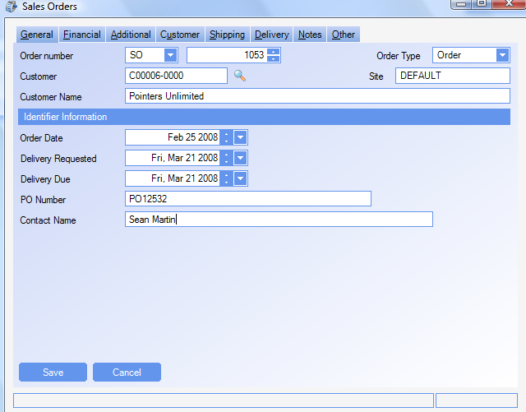
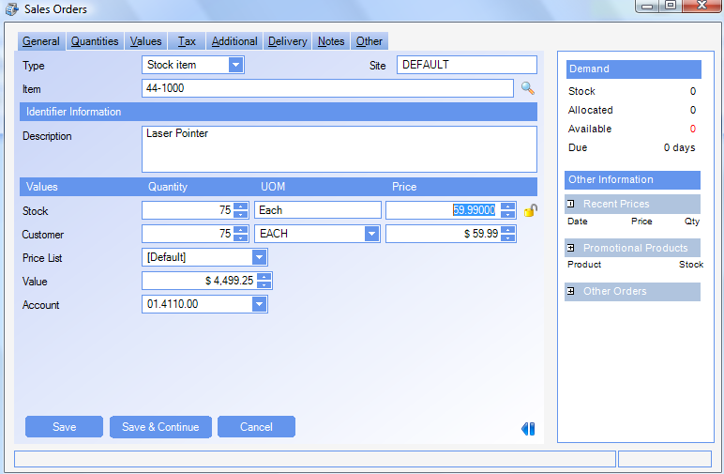
MRP Demand
MRP calculated dependent demand. Independent demand comes from orders and forecasts.
Due date March 21, 2008
Notice the available to promise.

Slide 15
MRP Demand
After running MRP we can see our demand and where it came from.

Slide 16
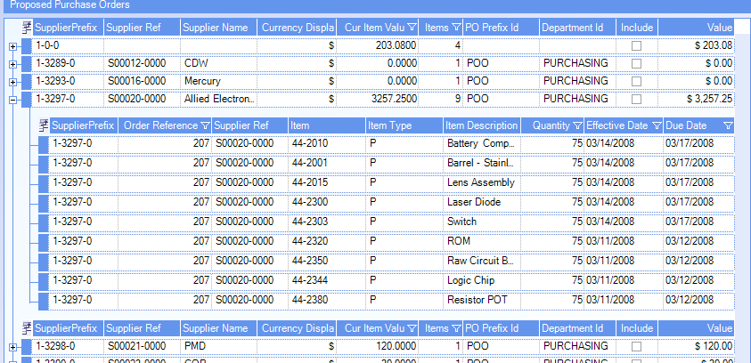
MRP Demand
MRP also suggests purchases based upon requirements. If some items were in stock, MRP would lower its recommendations accordingly.

Slide 17
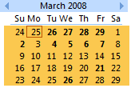
MRP Demand
Delivery due 3/21
MRP sets Manufacturing Order due date 3/20 for Laser Pointer
release date 3/18
Subassembly Logic Board due date is 3/17 so it can be supplied on 3/18
release date 3/13 (order spans weekend)
Laser Pointer components due 3/17
Logic Board components due 3/12
SYSTEM SETTING: When calculating due dates for manufactured items, the manufacturing calendar will be used to determine the due date. By default if the lead time of the item is less than 90 days the manufacturing calendar will be used. If the lead time is greater than 90 days, WinMan will use an open calendar and simply count calendar days. Use the MRP system option Number of days leadtime after which working days will not be taken into account, to increase the number of days that the manufacturing calendar will be used. Enable the option and set the value to the number of days required, typically the longest lead time for a manufactured item.

Slide 18
Executing the MRP Plan
The process begins with the buyers who review the Orders Summary Processing screen which shows by Supplier, proposed purchase orders.
Suggested suppliers are determined by the supplier cross reference. When multiple supplier cross reference records exist, the supplier with the lowest sequence number with a lead time within the requirement will be selected
SYSTEM SETTING: To always use the supplier with the lowest lead when the due date can not be met by any supplier select the Supplier Cross Reference system option Determines whether the supplier with the lowest lead-time gets selected if no records meet the due date criteria. Enable the option and set to Y to use shortest lead time as the criteria for selecting a supplier.
SYSTEM SETTING: To always use the default supplier use the MRP system option Always use the default supplier regardless of leadtime. Enable the option and set the value to Y to always use the supplier with the lowest sequence number regardless of leadtime.
Note: This profile will override the above setting if both are used.

Slide 19
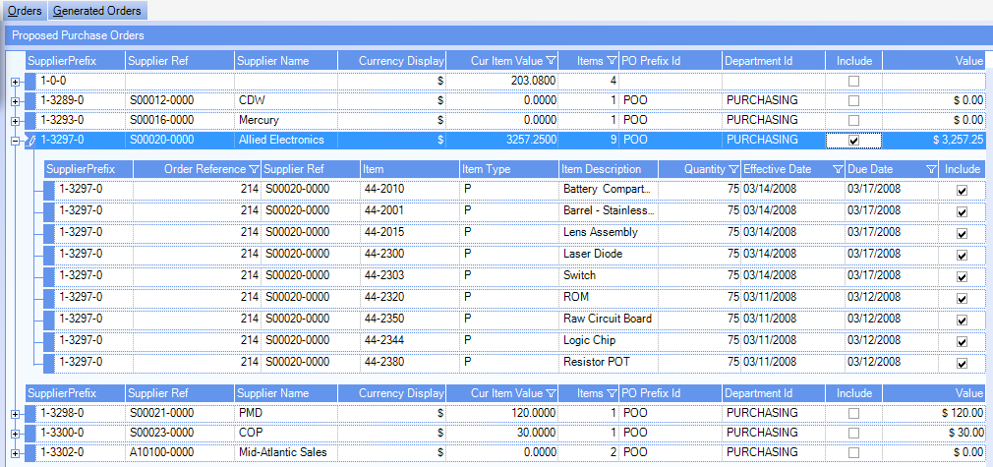
Executing the MRP Plan
All of the items for a supplier can be chosen by clicking on the “Include” checkbox for the supplier.

Slide 20
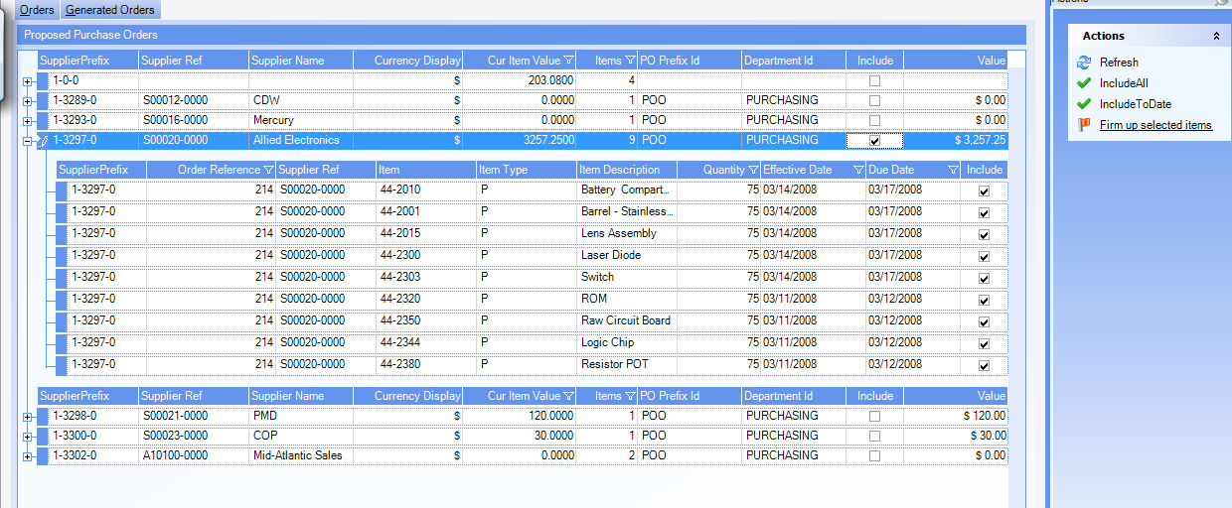
Executing the MRP Plan
All of the items for a supplier can be chosen by clicking on the “Include” checkbox for the supplier. Next we firm up the proposed orders.

Slide 21
Executing the MRP Plan
Once the proposed orders have been firmed, they can be viewed on the Generated Orders tab. Orders can be drilled down to for final review and sending of the Purchase Order to the vendor
SYSTEM SETTING: When orders are firmed, by default a Firm purchase order is created. To have New purchase orders created (and manually Firm the PO) use the Orders Summary Processing system option Create and use existing new orders instead of firm orders. Enable the option and set the value to Y for New orders to be created.

Slide 22
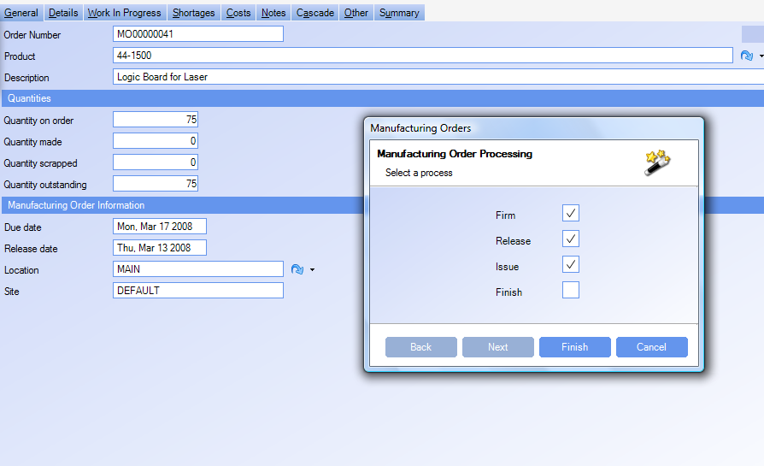
Executing the MRP Plan
The next step is to launch the order with the supplier, receive the parts then begin working on the subassembly, the 44-1500 (Logic Board).

Slide 23
Executing the MRP Plan
Manufacturing Orders generated by MRP are created as Proposed.
Proposed orders do not have their requirements fixed until the order has been firmed. Making changes to a Bill of Material for a proposed item will have the changes generate requirements the next time MRP is run.
SYSTEM SETTING: Proposed manufacturing orders generated in MRP will have a default prefix of MRP. To change this prefix, use the MRP system option MRP proposed manufacturing orders prefix. Enable the option and set the value to the required prefix.
SYSTEM SETTING: When the proposed manufacturing number becomes to large, the MRP manufacturing order number can be reset to 1. Use the MRP system option Resets the manufacturing orders counters to 1, enable the option and set the value to Y to reset the value.
NOTE: Once MRP has run and reset the counter, you must disable this option or each subsequent MRP run will reset the counter.

Slide 24
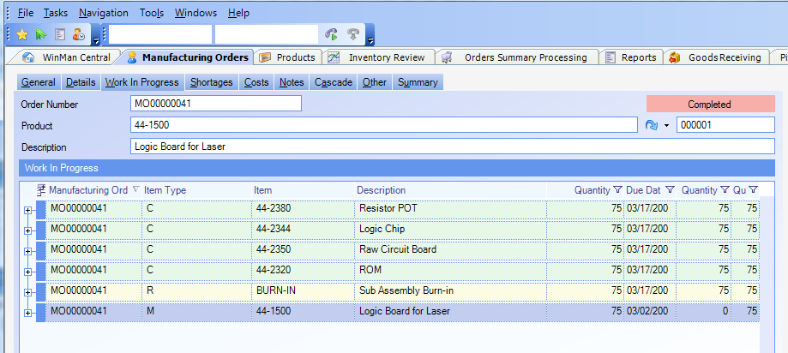
Executing the MRP Plan
The final step is to finish the order. This step receives the final assembly into inventory.

Slide 25
Other MRP Options
SYSTEM SETTING: MRP will generate proposed orders when the items are required. Use the MRP system option Consolidate orders within leadtime, to combine orders within the lead time of the item into 1 order. Enable the option and set to Y to use this setting. This is especially helpful for items that have long set-up times.
SYSTEM SETTING: By default, when MRP generates orders, it will suggest the date before it is required. For example, if a WIP component is required on Oct 26, the PO for the component will have a due date of Oct 25. WinMan can use “Optimistic” logic where the component will be scheduled to arrive the same day as required. In the example above, the PO would have a due date of Oct 26. To use this functionality, enable the MRP system option Use optimistic logic for supply and demand on the same day, and set the value to Y
SYSTEM SETTING: A planning buffer can be used to add additional time to the procurement lead time to add safety time. A planning buffer exists at the product level, and will be used over the global setting. To use a global setting, enable the MRP system option Planning buffer, and set the value to the number of days that should be added to the lead time
Note: Buffers allow waste to be created so caution should be used with buffers
SYSTEM SETTING: When using re-order points, a proposed order will be created regardless of demand exists for the item. Use the MRP system option Re order products when there is no demand to not create proposed orders for re-order points unless there is demand for the item.

Slide 26
Other MRP Options
SYSTEM SETTING: When a purchased item is required in a time shorter than the lead time, MRP will suggest an order for when it is required. Typically, the buyer will either accept the date and pay an expedite fee or move the due date of the PO. If the PO date is moved out, MRP will continue to propose a PO for the first date. These PO’s can act as signals to monitor the true PO, however, to prevent them from being created, use the MRP system option Suppress POs in Leadtime if demand to satisfy is available in leadtime. Enable the option and set the value to Y to use this option. To avoid excess PO’s from accidently being created, it is recommended to use this option.
SYSTEM SETTING: When a manufacturing item is required in a time shorter than the lead time, MRP will suggest an order for when it is required. Typically, the planner will move the due date of the MO as the lead time is not something typically changed. When the MO date is moved out, MRP will continue to propose a MO for the first date. These MO’s can act as signals to monitor the true MO, however, to prevent them from being created, use the MRP system option Suppress MOs in Leadtime if demand to satisfy is available in leadtime. Enable the option and set the value to Y to use this option. To avoid excess MO’s from accidently being created, it is recommended to use this option.

Slide 27
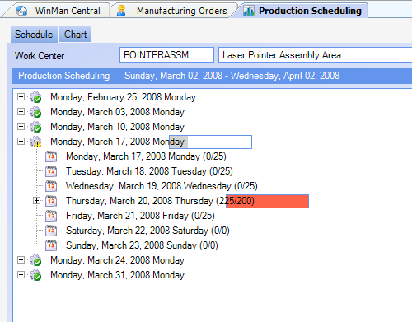
Production Scheduling
We can view our capacity by viewing the Production Scheduling module. We can see that the week of March 17 we have lots of capacity, but on Thursday, March 20 we have exceeded our capacity. Note the color coding.
Capacity is determined by the capacity in the activity center.
WinMan is an Infinite capacity scheduling system, which means if there isn’t enough capacity, required action must be done manually

Slide 28
Production Scheduling
We can look at that specific day and see all of the jobs scheduled, see the status of the manufacturing order, and see the resource requirements.
SYSTEM SETTING: Days can be grouped together to simplify viewing. By default WinMan will group 7 days together (1 Week). However, other logical values might be 1 day or 31 days (month view). To change the bucket size, use the Production Scheduling system option Bucket size. Enable the option and set the value to the number of days to be grouped together.

Slide 29
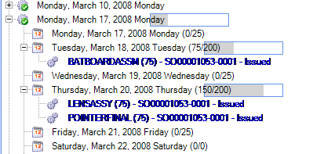
Production Scheduling
Looking at screen, we can see that we are over capacity on Thursday. We can drag the first operation and move it to another day. Here we moved it to Tuesday. Notice that now I have enough capacity to make the units. When re-scheduling, drag the MO line and drop on the calendar icon of the new date.
Scheduling uses the offset lead time of the process from the Bill of Material to determine when activities should be scheduled. Once the MO is Firmed, the offsets are locked in place, and changes to the schedule must be done in the Production Scheduling module.
Moving a MO will cause the remainder of the order to be rescheduled. If a work order is moved forward, the activities ahead of it will be rescheduled. If a work order is moved back, the previous activities will be rescheduled.

Slide 30
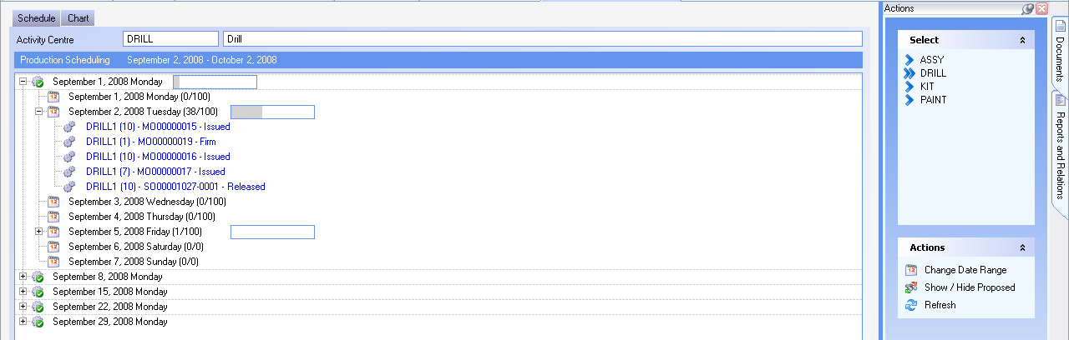
Production Scheduling
The production schedule is viewed by activity center. Select the activity center in Actions to view capacity requirements for each Activity center
Proposed orders can be viewed in the production schedule by selecting the action Show/Hide Proposed. Proposed orders can not be scheduled but used as reference to see potential scheduling conflicts
The default date range is 1 Month. To change the date range, select the action Change Date Range and select a different date range. Different date ranges can be used to see either larger or smaller schedules.

Slide 31
Labor Reporting
Labor can be recovered using a standard labor value or actual value. Standard labor is added to an item during the finish process of a manufacturing order
A direct labor value can be added to a Manufacturing Order using the Add Cost action in the Manufacturing Orders
The Time Sheets module can be used to track time against a Manufacturing Order, Job or GL account.
The Labor Recordings module can be used to track real time labor against a Job or Manufacturing Order

Slide 32
Labor Reporting
WinMan can track labor through the Labor Recordings module. The Labor Recordings module is used to track labor in real time.
Use the action Book In/Out to start or finish booking time. Time must be booked against either a Job or a Manufacturing Order. Only open Jobs or Released/Issued Manufacturing Orders can be booked against.

Slide 33
Labor Reporting
A process can be used to track what operation was completed during the labor recording.
The time in will default to the current time.
SYSTEM SETTING: By default Time in and Time out can be altered by the user to allow for any corrections. However, to prevent any changes to the times and only use the default time, the Labor Recordings system option Make the Times read only can be used. Enable the option and set the value to Y to have times read only.
SYSTEM SETTING: By Default the book in time will default to the current time. However in the case where something has already been booked off, the previous book off time can be used as the book in time regardless of the current time. Use the Labor Recordings system option Automatically suggest the book in time to be the last book out time for the current day. Enable the option and set the value to Y to use previous book out time.

Slide 34
Labor Reporting
The activity center will default to the activity center of the selected process
The labor rate will default to the labor rate assigned to the user
The department will default from the user
The GL account is the account that the labor will get expensed to. For manufacturing orders this will be the labor account for the parent item. For jobs this will be the default labor account in the system set-up.
SYSTEM SETTING: Users have the ability to change the default GL account. To prevent users from changing the GL account, use the Labor Recordings system option Make the GL Account read only. Enable the option and set the value to Y to prevent users from changing the GL account.

Slide 35
Labor Reporting
Time Sheets can be used to record labor for Jobs, Manufacturing Orders or as expenses to GL accounts.
Time Sheets are typically used when employees record time outside of WinMan and need to get a daily accounting entered.
Since Manufacturing Orders typically need to be finished in a timely manner, time cards are not recommended for MO’s.
Once a Time Sheet has been entered it must be processed before the labor values will be added to the MO/Job or posted to the GL when the item type is GL account.

Slide 36
Labor Reporting
ID – Assigned automatically when a new Time sheet is created
Effective Date – The date the transaction will post to the GL
User – The user that the time card is for
Labor Rate – The labor rate related to the selected user
Control total – The total value of labor for the entire time sheet if known. This can be used to ensure all line items are entered before processing

Slide 37
Labor Reporting
Adding Line items
Type – An MO, Job or GL account
Item – The specific item that the labor will get expensed to
Process – The process that the time relates to
Date – The date that the activity took place on
Hours and Minutes – The amount of time used
Cost – Multiplies the time by the labor rate to generate a cost
Value – The billing rate of the labor
Activity Center – The Activity center for the selected process
Labor GL account – The labor account that will be used for the transaction
Department – The department of the selected user
SYSTEM SETTING: The value and cost fields can be removed from the screen to prevent users from seeing labor values. Use the Time Sheets system option Determines whether the labor values are displayed to the user, enable the option and set the value to N to remove labor values.

Slide 38
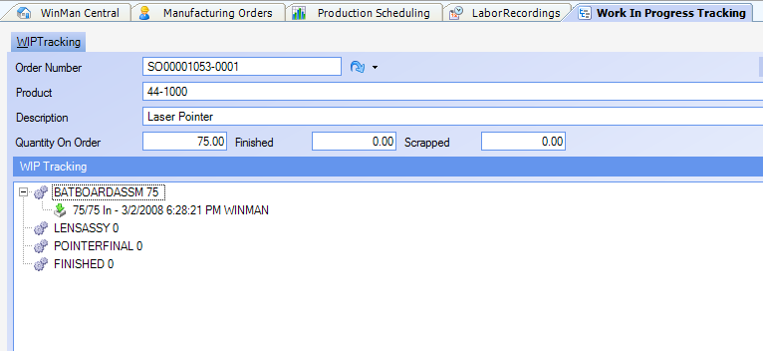
WIP Tracking
WinMan also tracks the WIP through the operations. WIP is booked in to operations by right clicking on the operation and selecting “Book In”. Labor Recording does not check WIP into or out of an operation.

Slide 39
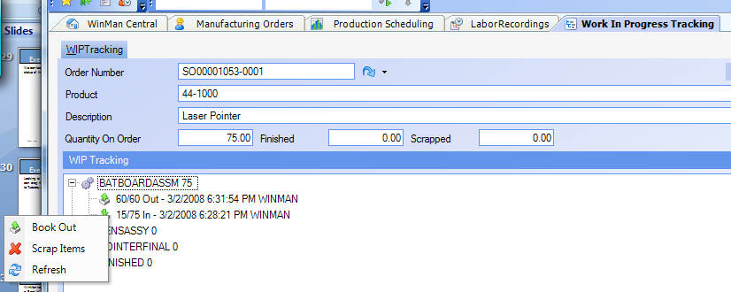
WIP Tracking
Once all of the stock has been booked in, the system will only allow for booking out. Below 60 have been booked out but 15 remain open in the operation.

Slide 40
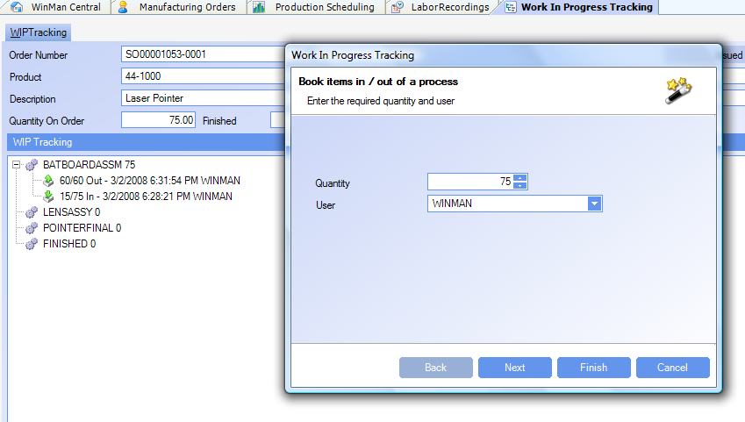
WIP Tracking
The system will permit booking in of the quantity in the previous operation. Below, we can book in 75 even though only 60 have been booked out. Looking at the screen below, we know that at least 60 is in transit.

Slide 41
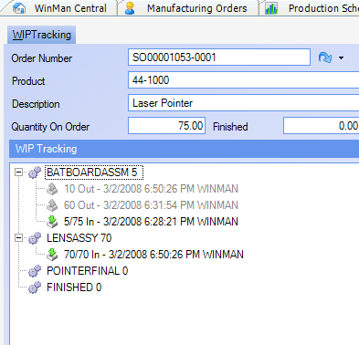
WIP Tracking
If 70 are booked into the LENSASSY operation, we see the entries generated for the BATBOARDASSM. Notice that another line was created for the 10 that were added to the moved 60. Next to the operation we see the amount remaining in the operation. When the full amount of WIP is received by the “Finished” operation, the Manufacturing Order is considered completed.

Slide 42
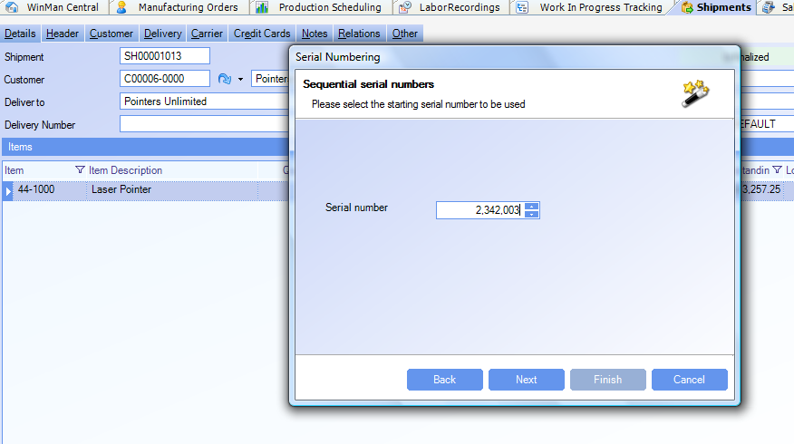
Shipping Serial Numbers
If the end item is under serial number control and you want to issue the serial numbers at shipping time, you can assign a starting serial number, give the serial numbers a prefix, enter them manually, or apply a single number to the whole batch. This permits tying the serial number (or lot) to a specific manufacturing order.

Slide 43
More on Serial Numbers
There are situations where a company needs to know what exactly what components went into an assembly, down to the serial and lot number of the components. In those cases, you need to operate in lot sizes of one since you must issue specific components (by lot or serial number) to the assembly. Many medical devices have this requirement.
Having serial controlled components and not serializing the assembly will allow you to know what lots/serial numbers went into the assembly. WinMan by default puts a lot number (the Manufacturing Order Number) on each manufactured batch.
SYSTEM SETTING: By default, duplicate serial numbers can be used in WinMan. To prevent duplicates from being used, enable the Serial Numbers system option Allow duplicate serial numbers. Set the value of the option to N to prevent duplicate serial numbers in WinMan.

Slide 44
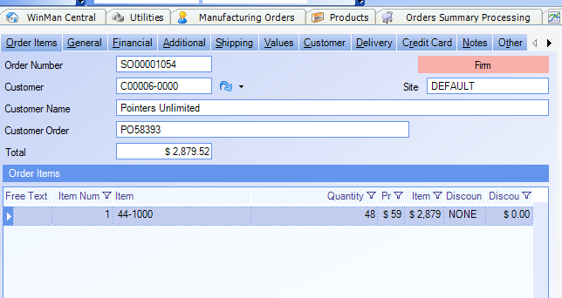
Kanban Controlled Items
Kanban items are not planned by MRP. Children of kanban assemblies are planned by MRP. To follow the process, we start with an order of 48 Laser Pointers (44-1000)

Slide 45
Kanban Controlled Items
MRP creates a planned order for the main assembly (44-1000) and but not for the Logic Board (44-1500) that goes into it because it is a kanban controlled item.

Slide 46
Kanban Controlled Items
MRP does create requirement for the kanban assemblies. This is particularly important for companies in a mixed mode environment where some assemblies are kanban controlled and others are not but they all use common components.

Slide 47
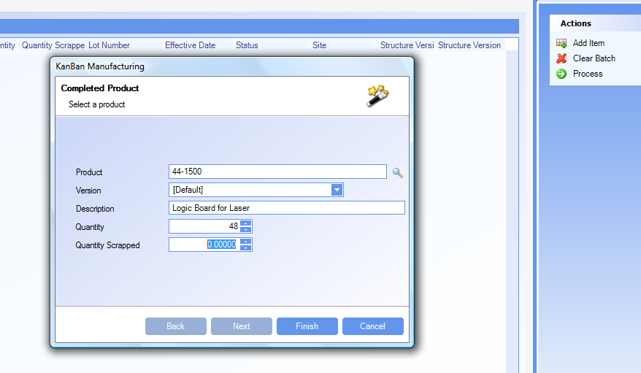
Kanban Controlled Items
Kanban manufacturing consists of adding the item produced to the Kanban Manufacturing screen.
When an item is backflushed, a manufacturing order is created, items are issued on a FIFO basis and the MO is completed. The completed MO puts the assembly into Inventory.
If there is not enough inventory in the system to complete the backflush, a shortage will be indicated. The Manufacturing order that was created can be drilled down to by right clicking on the Kanban line. The shortage should be addressed and the MO finished manually

Slide 48
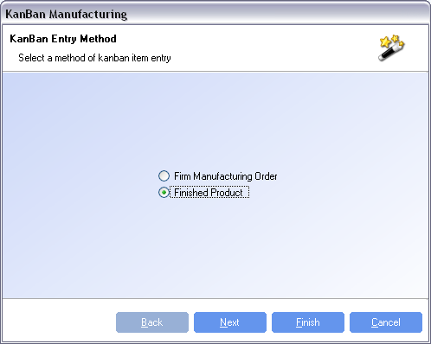
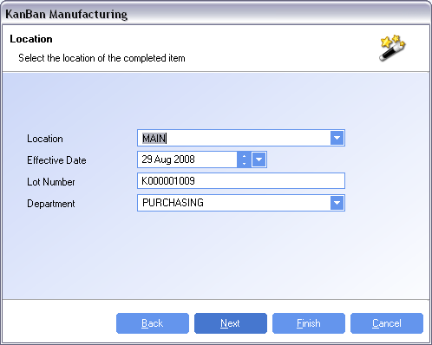
Kanban Controlled Items
SYSTEM SETTING: Additional information can be entered when creating a Kanban if the long form entry is used. Enable the Kanban Manufacturing system option Kanban Short form entry, and set the option to N to use the long form. Long form entry allows you to select either a product or existing manufacturing order to backflush. Additionally, location, date, lot number and department can be modified before the backflush is completed.

Slide 49
Kanban Controlled Items
Once a batch has been added to Kanban manufacturing “Actions” allow a new item to be added, clear the batches or process the batch.
Clearing the batch means no action has taken place. Processing the batch produces the assembly and consumes the components.
For this example, we are going to report that we made 48 and scrapped 2.
SYSTEM SETTING: Items completed from a Back-flush will be assigned a lot number starting with a “K”. To change the prefix select the Kanban Manufacturing system option Lot Number Prefix, enable the option and enter the required prefix as the value of the option.

Slide 50
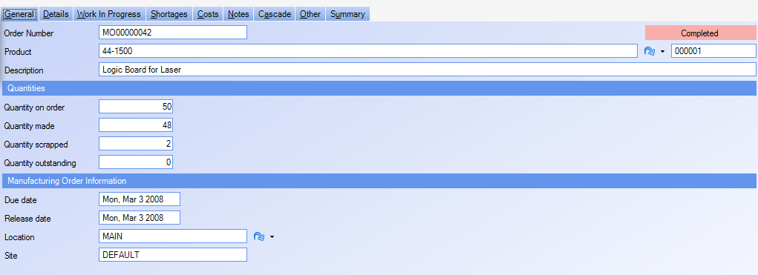
Kanban Controlled Items
In the background, WinMan creates a Manufacturing Order. It does this in order to capture all of the costs.
Below is the order created by WinMan. Notice that the quantity on order is 50 and the quantity made is 48, scrapped quantity is 2. Notice that the MO is also considered completed.

Slide 51
Kanban Controlled Items
Looking at the MO we can see that 50 units of each component was consumed to make the 48 units. The material cost of the 48 units is equivalent to the sum of 50 of each component. The labor is also the value of 50 units. Since kanban manufacturing backflushes the components, it is assumed that all 50 units were made and only 48 were acceptable.

Slide 52
Backflushing Defined
Backflushing is similar to issuing inventory except it is done at the end of the process. If the product was made then these components must have been consumed.
Backflushing can be used when cycle times are relatively short. Since the components are not issued at the time the order is started, it is possible to believe that there is more available inventory than there really is. Processes that take several days or longer will usually be handled with Manufacturing Order Issues. Cycle time measured in hours are good candidates for backflushing.
The big advantage to backflushing is that it takes fewer manual transactions.

Slide 53
Backflushing Results
This view of Inventory Review shows the consumption of the ROM and the production of the Logic Board.

Slide 54
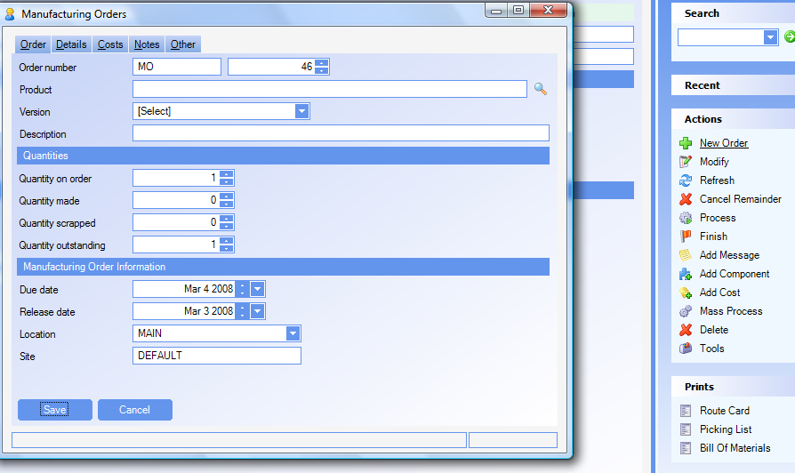
Master Scheduling
A master schedule is created simply by entering manual Manufacturing Orders. Master Scheduling is typically done when you want to drive demand through Manufacturing Orders and not outside demand. A manually created MO is always saved as a FIRM order.

Slide 55
Cascading MOs
Cascading MO’s are used to create child MO’s with the same base MO number for tracking purposes.
Cascading MO’s must be used with the Product option to Generate a MO for each sales order.

Slide 56
Cascading MOs
Use the Cascade Tab in Manufacturing Orders to view all child Jobs
Right click on a child MO and select Go to Manufacturing Orders to drill down to the child MO
The parent MO must be firmed before MRP will generate the child MOs

