Slide 1
Product Training Configurator
Where “Lean” principles are considered common sense and are implemented with a passion!

Slide 2
Overview
The Configurator module is used to define products which have features and options which can be selected in a variety of combinations resulting in a potentially huge number of unique bills of material. It would be impractical if not impossible to create every one of these so one can be selected when a customer places an order. Many possible combinations would never be required and would therefore have consumed a lot of valuable time and resources in their creation; they would also clutter the database and obscure the useful data.
The configurator enables a relatively small number of products or models to be defined with all their available options including rules for determining which can be selected with another, e.g. on a car a sun-roof can be selected on a saloon body style but not on a roadster.
When a user is entering a sales order and selects a product which is defined as ‘Configured’ that user will be presented with a list of available options and can select whatever is required.
Each time a product is configured in this way it creates a new product and a unique BOM.

Slide 3
A Configured Product
We are going to configure a WinMan Automobile that has the following rules.
Option Group | Option | Electric (33-050) | Combustion (33-060)
Transmission | CVT (33-100) | Y | Y
 | 6 Speed (33-110) | N | Y
Color | Green (33-201) | Y | Y
 | Blue (33-202) | Y | Y
 | White (33-203) | N | Y
Towing | Light Towing (33-301) | Y | Y
 | Heavy Duty (33-302) | N | Y

Slide 4
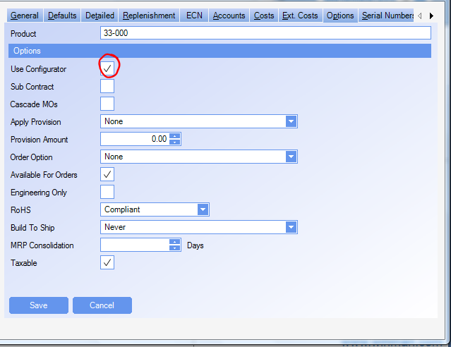
A Configured Product
On Options tab, you click to select the “Use Configurator” box.

Slide 5
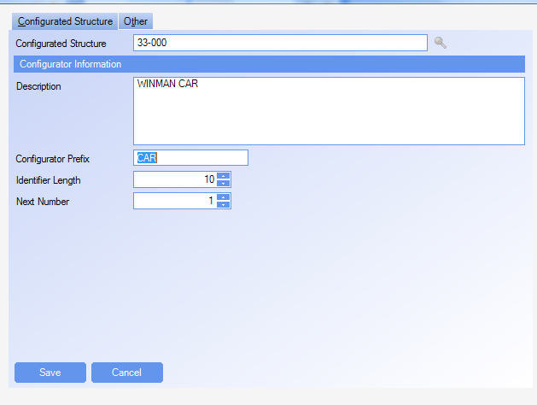
A Configured Product
The Configurator module (by default found under Manufacturing) allows us to add an item to be configured.

Slide 6
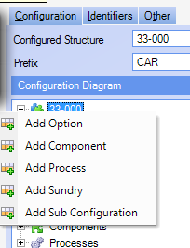
A Configured Product
We begin by adding the options we have to offer. In our example, that would be:
Engine
Transmission
Color
Towing Package
Options are added at the top level by right clicking on the product (33-000). To add options within options, simply right click on the option to be the parent of additional options. For instance, in our example, if we wanted different kinds of internal combustions engines, we would add an engine type and perhaps diesel or gasoline option items.

Slide 7
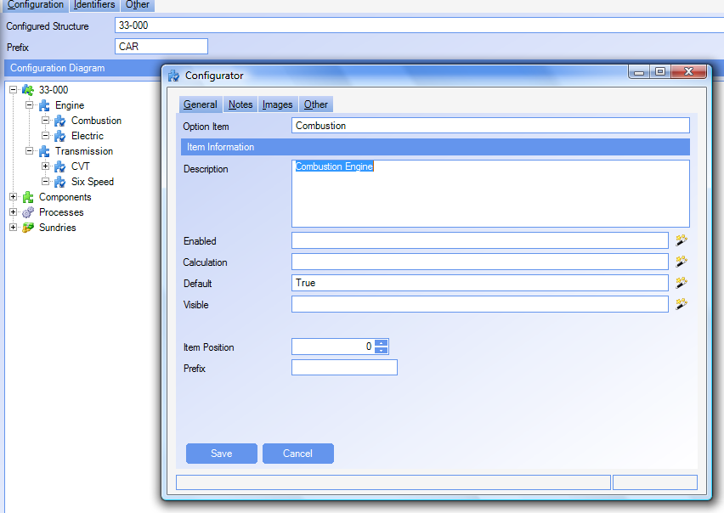
Option Item
Here we have added the combustion engine as an “Option Item” to the Engine option. In this case we want this engine to be the default, so we put “True” into the default field. The “default” field is set when the configuration is loaded. If you want an option to be the default when a specific action is chosen, use the “Calculation” field. The prefix field helps build the configuration part number depending upon the system options.

Slide 8
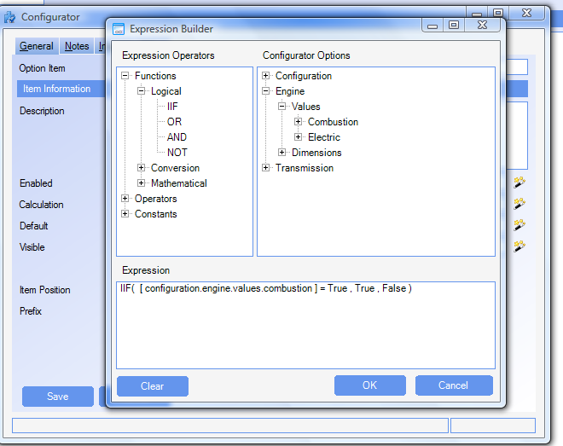
Option Item
Our six speed transmission is only available with the internal combustion engine and cannot be bought with the electric motor. We build the proper expressions using the Expression Builder (we get to it by clicking on the Wizard symbol next to the expression for which we want to build the expression).

Slide 9
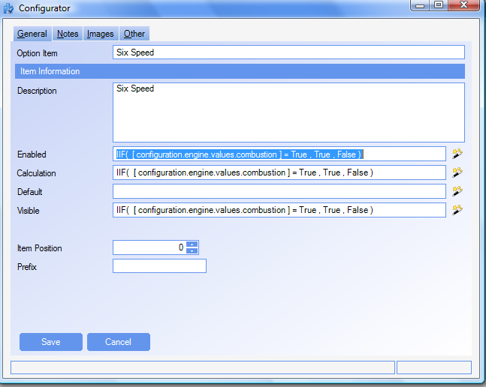
Option Item
This option is only enabled if the ICE (combustion engine) is chosen because we put that as a condition. It is also the default for the ICE, made so by placing the same condition in the Calculation field. We don’t want the option to show up for any other choice, so we put a visible condition (same expression). If left empty, the option would have been visible but not selectable.

Slide 10
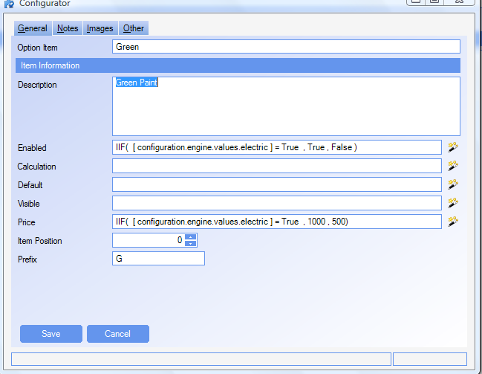
Option Item
For our color, we wanted to do a special double coat of green for the “Green” electric version. Any other green auto gets the regular coat. We also are charging more for the electric version of the green. Notice the price line.

Slide 11
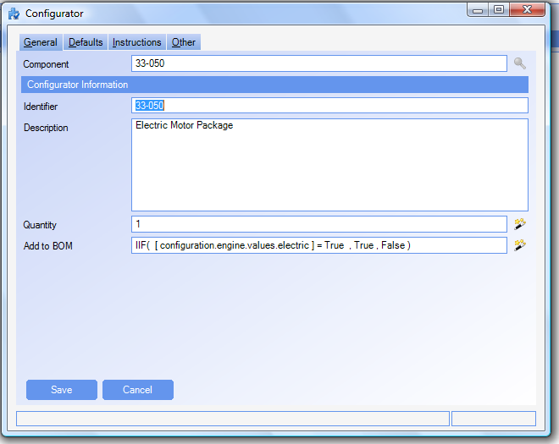
Components
Adding a component is similar to adding an option item. We fill in the Add to BOM field the same way we added to the option item expression field. Here we put in all of the conditions that would cause an item to be put into the structure. For the Electric Motor Package, we want it if the electric option is selected.

Slide 12
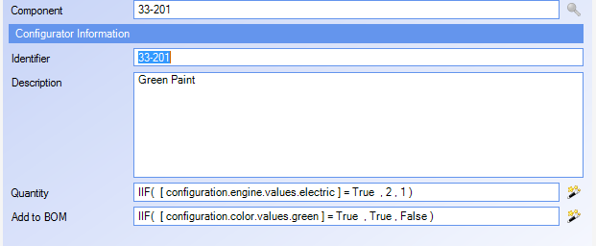
Components
Since the electric option gets 2 units of Green Paint we can put an expression in the quantity field that will cause 2 units to be used for only the electric option.

Slide 13
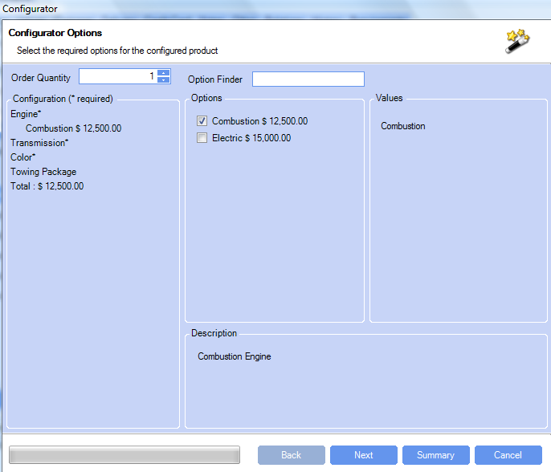
Sales Order
When the WinMan Automobile is selected as an item in a sales order, the configuration window pops up.

Slide 14
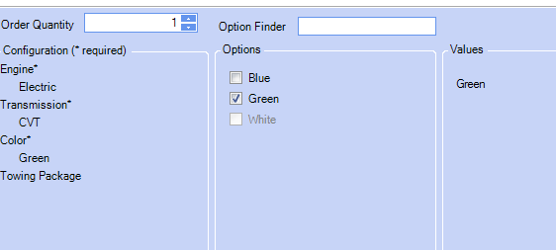
Sales Order
Notice that the Towing Package does not have an asterisk (*) next to it. That is because we put “True” in the Allow No Selection field of the option.

Slide 15
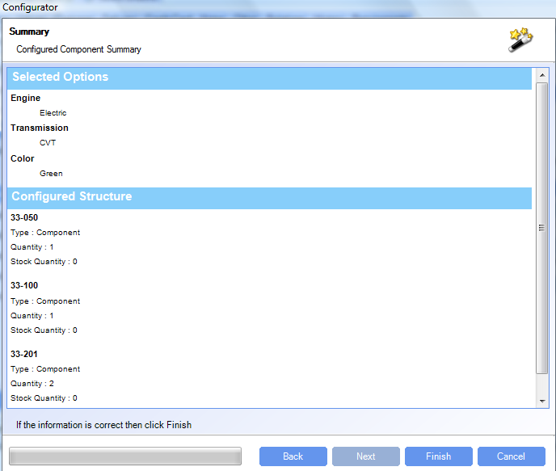
Sales Order
Here is the summary of our selections.

Slide 16
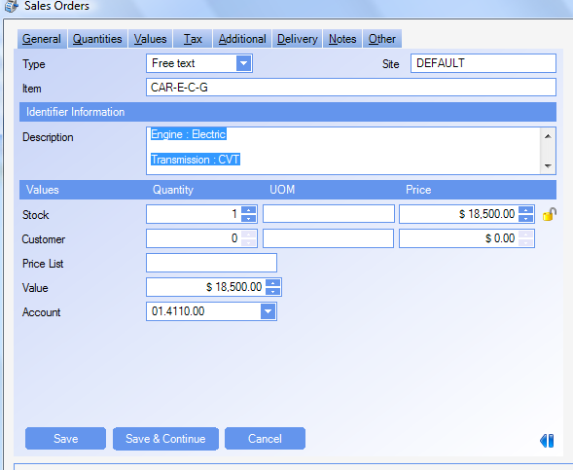
Sales Order
The sales order line that is generated has a the generated item number based upon the selected options. The price is a sum of the options.

Slide 17
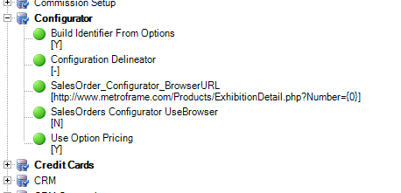
Option Settings
The option settings affect the way the configurator works.
We can set the separator that makes up the configured item number, determine how the number is built (from Prefix or generated), and if the options contain the pricing.

