Slide 1
Product Training
Jobs
Where “Lean” principles are considered common sense and are implemented with a passion!

Slide 2
Jobs
A Job can be used to track costs for projects. Projects could be internal, such as R&D, or external, such as the sale of a custom or capital item.
Jobs consist of one job header and at least 1 line item. The job header contains information for the entire job such as the customer or job date. The lines contain information for each item on the job such as the item and quantity.

Slide 3
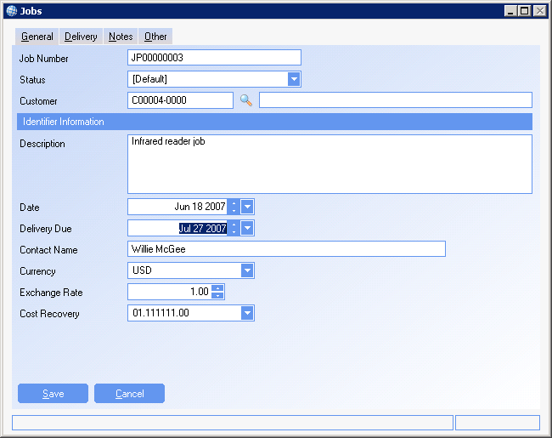
Job Header
General Tab

Slide 4
Job Header
Job Number – Select the job prefix and the next number for the prefix will automatically be used
Status – The status of the job. Statuses are created against the Job prefix and used for reporting.
Customer – The customer for the job. Enter either the customer name or customer number when selecting a customer. A specific customer should be created/designated for use with internal jobs.
Description – A description of what the job is
Date – The date of the job.
Due date – When the job is due for completion.
Contact – The contact from the customer master, but can be changed for the job
Currency – The currency of the customer
Exchange Rate – When using foreign currency, the exchange rate at which items will be billed at
Cost Recovery – Defaulted to the default Cost of Sale account

Slide 5
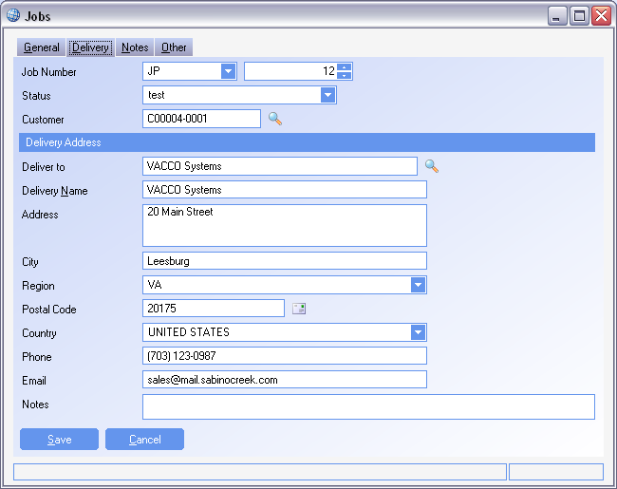
Job Header
Delivery Tab
The delivery address of the selected customer is automatically defaulted. Delivery information can be changed for the job by clicking in the field to be changed and updating to the correct address

Slide 6
Job Items
Multiple job items can be added to a single job. Estimated and Confirmed items can be added to a job. Job items are added to a job by selecting the action Add Item.

Slide 7
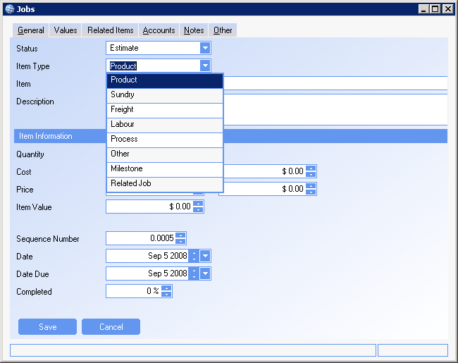
Job Items
General Tab

Slide 8
Job Items
      Status – The item can be either estimated or confirmed. Estimated items are used to generate a quote and to compare to the actual value. Confirmed items are the actual costs that are incurred for the job
      Item Type
        Both Estimated items and Confirmed Items
          Product – An item from the Product module
          Sundry – An item from the Sundry module
          Freight – A freight method from the Carriers module
          Labor – A labor rate from the Labor Rates module
          Process – A process/routing step from the Processes module
          Other – A free text item
        Estimated Items only
          Milestone – A milestone is a free text item to which other estimate items can be related. When a milestone item is added the user is prompted to select the estimate items to relate to it. When an item is related to a milestone it’s value is added to the milestone. Estimate items can also be added to a milestone by right clicking on the item in the grid.
          Related Job – An existing job for the customer.
        Confirmed Items only
          Received Item – A batch of stock identified by its Goods Receipt note
          Purchase Invoice Item – An item from a purchase invoice
          Sales Invoice Item – An item from a sales invoice

Slide 9
Job Items
      Quantity – The quantity of the line item
      Cost – The standard cost of the item if one is available. Used as reference.
      Price – The price that the item is being sold to the customer
      Sequence Number – The sequence number for ordering any Jobs prints created
      Date – The date the line item is entered. For Confirmed items, this is the date used to calculate what period the item will post to in the GL
      Due Date – When the item is due
      Completed – The percentage of the item that is completed. This is manually updated and used to track how far along the line is. It is also used on the Jobs dashboard.

Slide 10
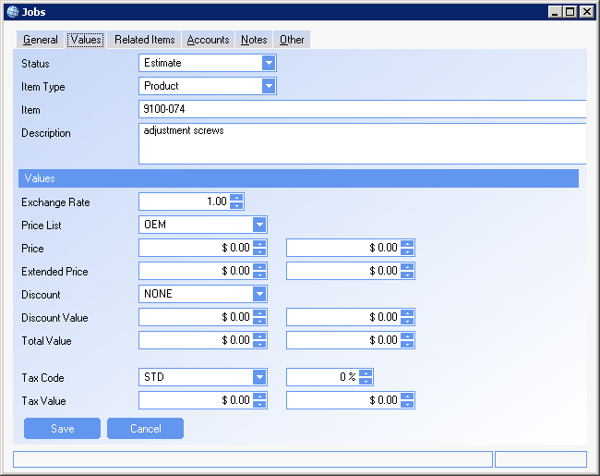
Job Items
Values Tab

Slide 11
Job Items
      Price List – The default price list from the customer master. Used to create default prices for any product that has a price list.
      Discount – The discount for the selected item.
      Discount Value – The Discount value calculated
      Total Value – The total extended price – the total discount
      Tax code – The applicable tax code used to calculate taxes
      Tax value – The value of tax for the line item

Slide 12
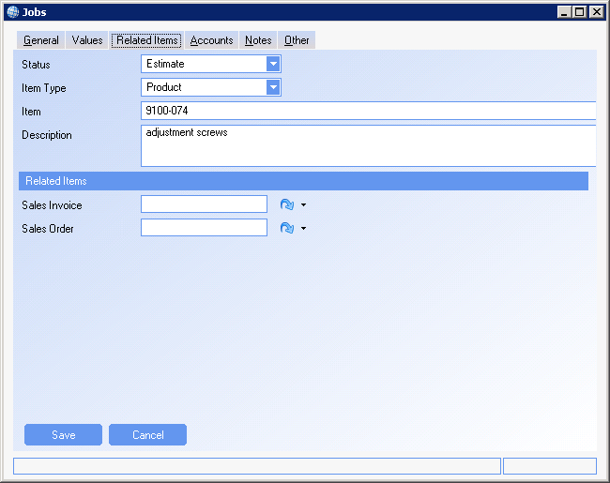
Job Items
Related Items Tab
Sales Invoice – The invoice created from the Jobs module for the line item
Sales Order – The sales order created from the Jobs Module
Note: It the sales orders is shipped and invoiced outside the Jobs module the Sales Invoice field will not populate

Slide 13
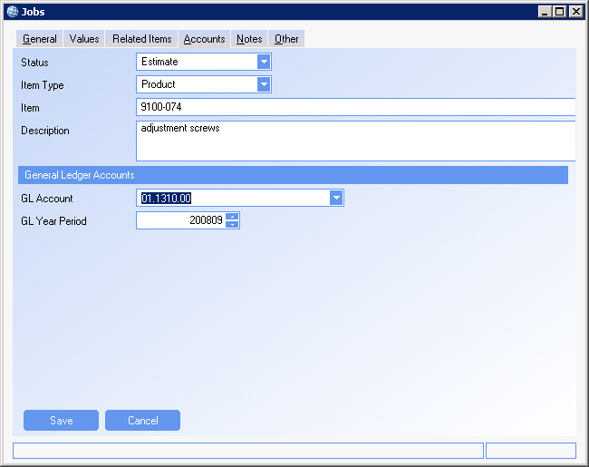
Job Items
Accounts Tab
GL Account – The default Jobs account as found in the system set-up. This can be amended by the user
GL Year Period – The period that the transaction will post to the GL. This is calculated based on the date selected for the line. To change the posting period, the user must change the date, and the period will automatically update. The period itself is for reference and not be changed by the user.

Slide 14
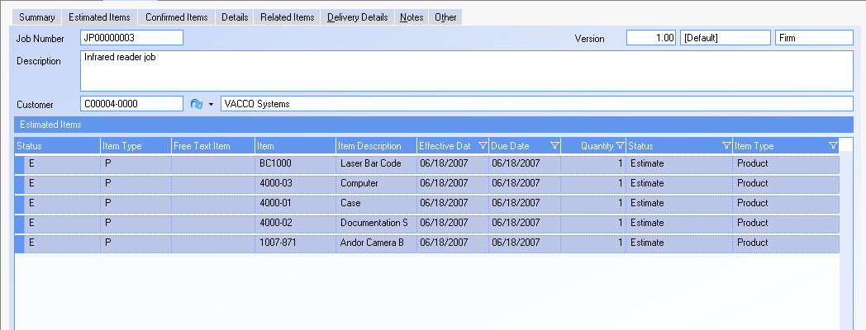
Estimated Items

Slide 15
Estimated Items
      Estimated items are found on the Estimated Items Tab
      Estimated items can be created into Quoted items. A specific line item can be right clicked on and selected for quote, or the action Create a Quote can be used to select any unquoted, estimated line items.
      A single quote can be created for the entire job or separate quotes can be created.
      Quotes can be viewed in the Sales Order module. They can be converted to a sales order, shipped and invoiced in the manner as if the quote was created manually.
      A bill of Material can be added to the Estimated items using the action Import a BOM. This action will add the top level BOM as Estimated items. The Import a BOM action only works for estimated items and not with Confirmed items
      Once a Job is firmed, the estimate items that are products, will become requirements to MRP and have proposed orders generated. To firm a job use the action Firm Job

Slide 16
Confirmed Items
Confirmed Items can be viewed on the Confirmed Items Tab
      Only Jobs that have been firmed can have Confirmed items added

Slide 17
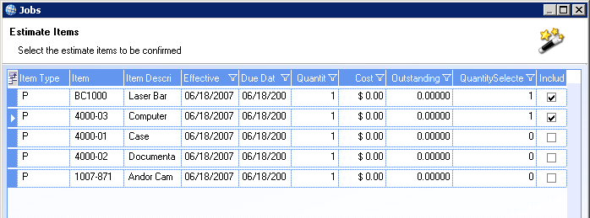
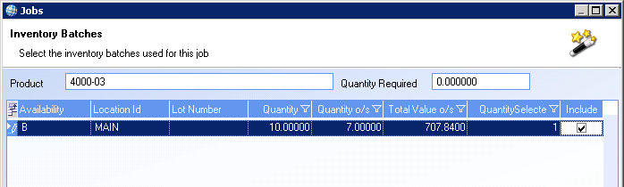
Confirmed Items
      Confirmed items can be added using Add item action, or using the action Confirm Estimate Items.
      Confirm Estimate Items can confirm any amount of estimate line items from the job
      Items selected to be confirmed are then issued to the Job.

Slide 18
Confirmed Items
The user can select to firm up either the whole or a part of an estimate item.
When an estimate item is firmed up it’s completed value is updated automatically (i.e. if 5 products are firmed up from an estimate item for 10 products then the estimate item will be set as 50% completed)
If the estimate item is related to a milestone then the milestone’s completed value will be updated automatically.
The estimate item’s cost outstanding and value outstanding will be reduced by the cost and value of the quantity of the estimate items being firmed up.
If a milestone item is firmed up then all of it’s related estimate items are firmed up automatically and set to 100% completed.

Slide 19
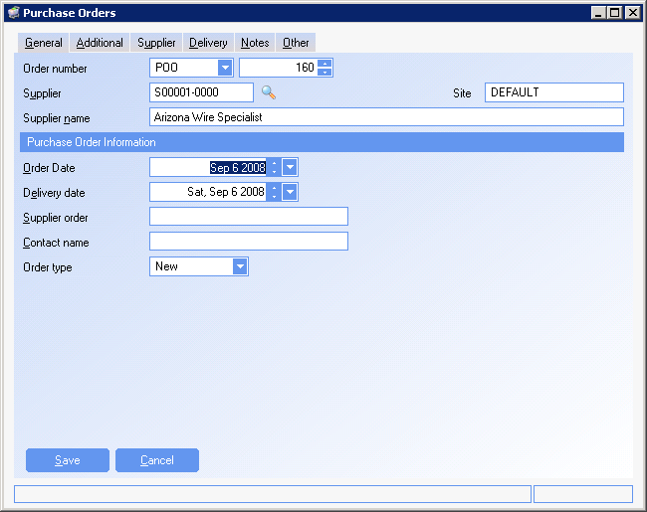
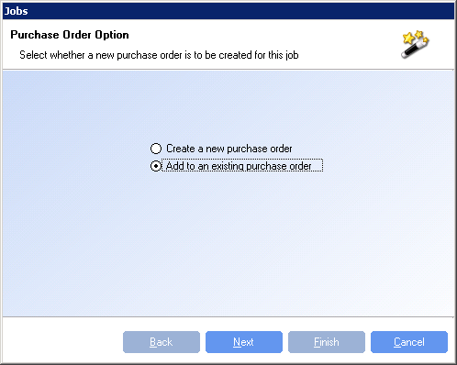
Jobs Actions
Purchase Item

Slide 20
Jobs Actions
Products can be purchased specifically for a job by clicking on the ‘Purchase Item’ action on the right hand menu. These items are added as estimate items
An option is available to create a new purchase order or to add an item to an existing purchase order that is related to the job.
The value of the purchased product is taken from the products material cost.
Purchased estimate items can be received by right clicking on the purchased estimate item and selecting ‘receive item’. Purchased estimate items can only be received on a firm job. If items are selected to be received on an estimate job then the user is prompted to firm up the job.
A new goods receipt will be created and related to the job. The received item is automatically issued to the job.

Slide 21
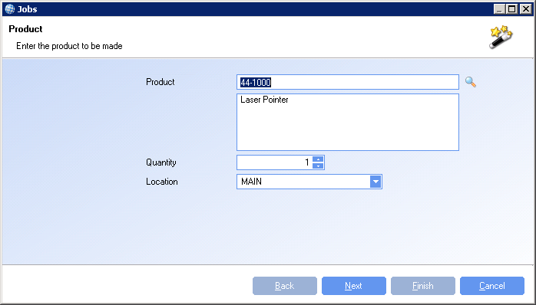
Jobs Actions
Make an Item

Slide 22
Jobs Actions
Items can be made by the job by selecting the Make an item action. The product and quantity to be made is selected. The confirmed items that were used to make the item are then selected from a grid of the confirmed items with a quantity outstanding.
The made item is added to inventory with a material cost calculated from the sum of the confirmed items used to make it. The confirmed item’s outstanding costs are reduced according to the quantity of the item that was selected to be included in the made item.
A cost recovery item is added to the confirmed items to reflect costs recovered by the made product. The cost recovery item is created with a value outstanding equal to the sum of the value outstanding of the confirmed items used to make it. The selected confirmed item’s value outstanding is reduced according to the quantity of the item that was selected to be included in the made item.

Slide 23
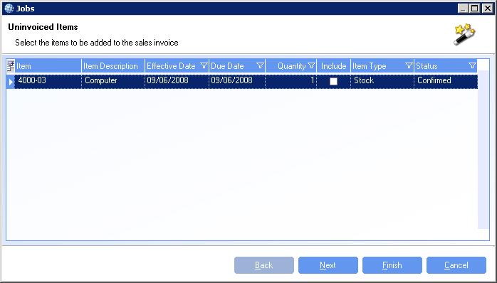
Jobs Actions
Create a Sales Invoice

Slide 24
Jobs Actions
Items can be added to sales invoices either by selecting the Create Sales Invoice action or by right clicking on a confirmed item in the grid.
The user can select the items to be invoiced from a grid of the confirmed items with a value outstanding.
An unfinalized sales invoice is created and related to the job.
A cost recovery record is added to the confirmed items to indicate the cost and value recovered by the sales invoice.

Slide 25
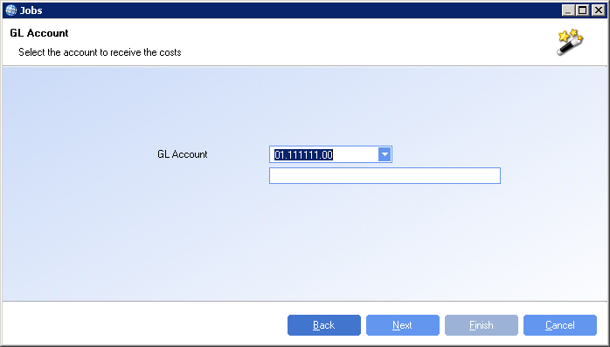
Jobs Actions
Relieve Costs

Slide 26
Jobs Actions
Costs can be relieved from a job by clicking on the Relieve Costs action.
Select the items to have their costs relieved from a grid of confirmed items with outstanding costs.
Select the account to relieve the costs to.
A cost recovery item is added to the confirmed items to reflect the costs that have been relieved.

Slide 27
Jobs Actions
Completing a Job
Jobs can be completed by selecting the Complete Job action.
If there are any confirmed items with outstanding costs then the user will be prompted to relieve those costs before the job can be completed.
Version Control
All jobs are created as version 1. To record a version of a job select the Version Control action.
The Version Control action will produce a report containing the jobs details and the items on the job at that point.
The report is saved as a document against the job and the version number will be increased by 1.

